Slide 1
Multimedia Computing
By
Minhaz Uddin Ahmed, PhD
Department of Computer Engineering
Inha University in Tashkent.
Email: minhaz.ahmed@gmail.com

Slide 2
Content
Matlab Introduction
Use of Octave
Google Colab/ Jupyter notebook

Slide 3
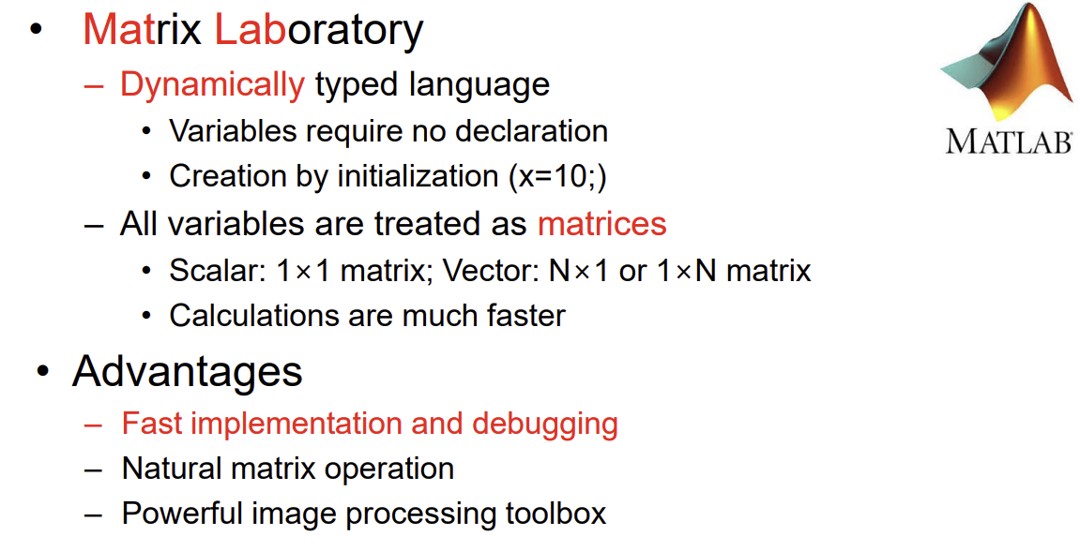
Matlab

Slide 4
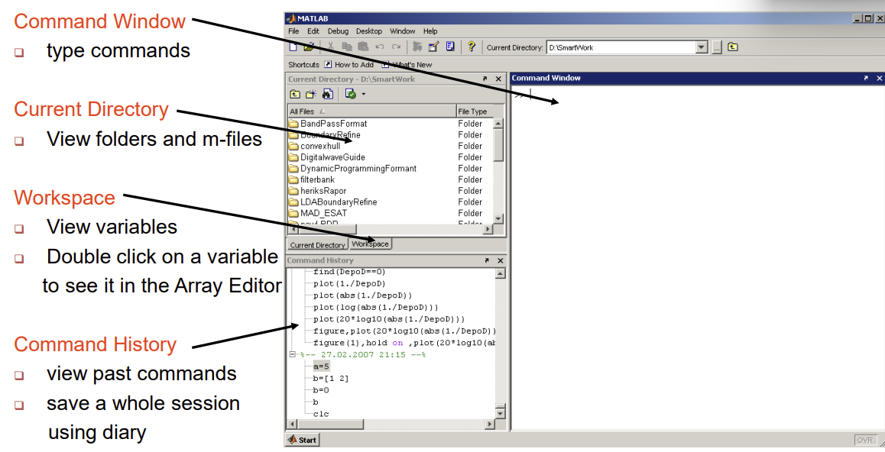
Matlab main screen

Slide 5
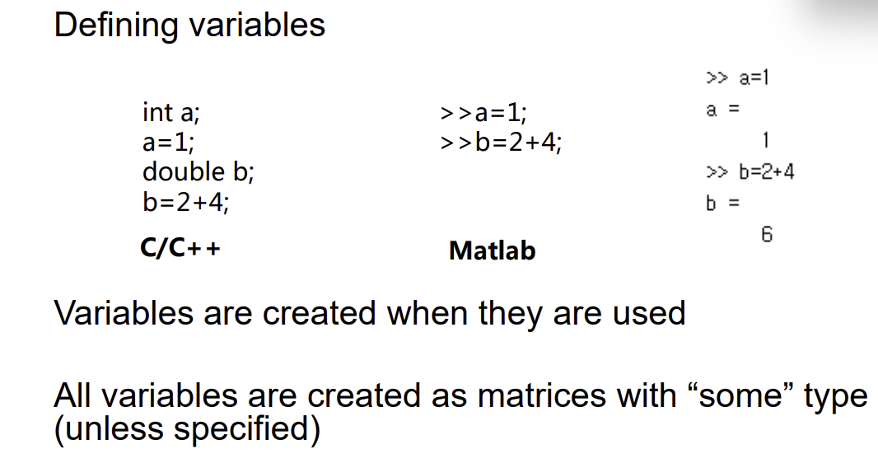
Variables

Slide 6
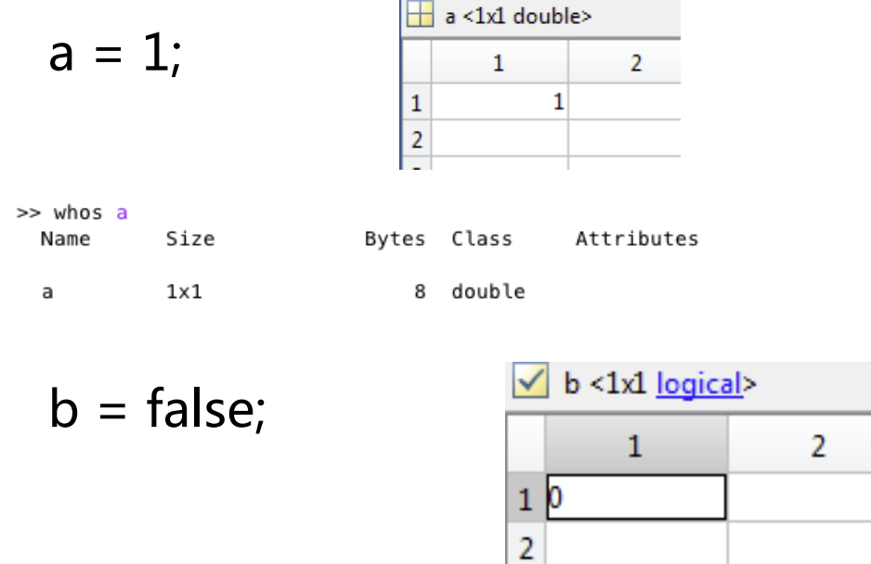
Variables

Slide 7
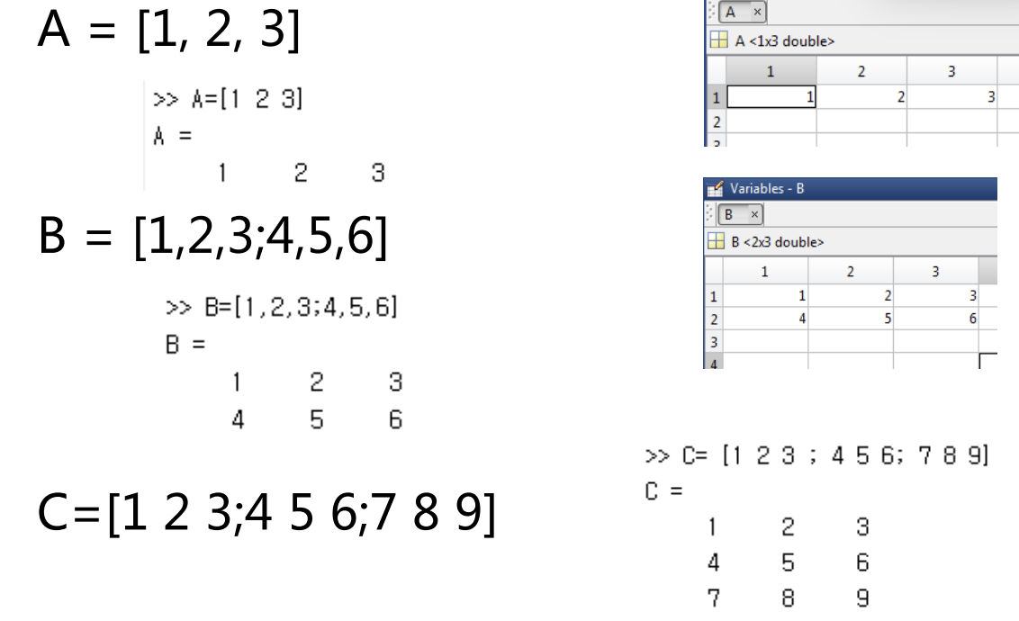
Variables

Slide 8
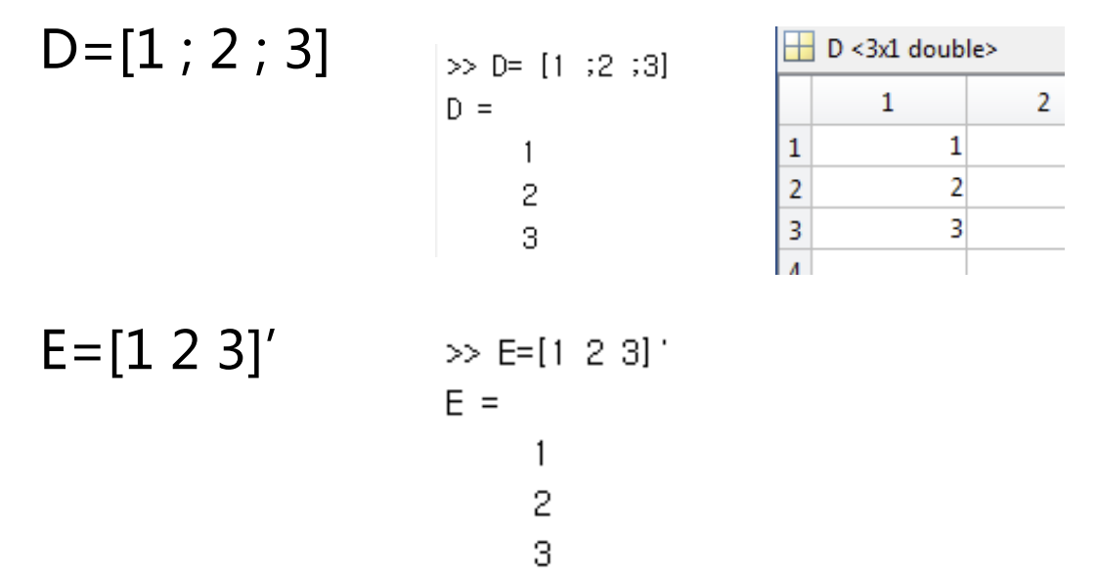
Variables

Slide 9
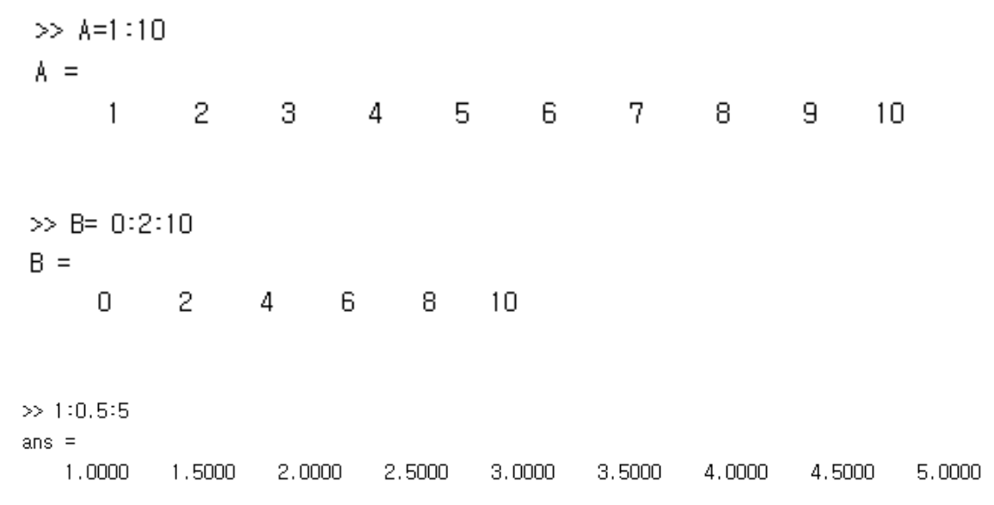
Variables

Slide 10
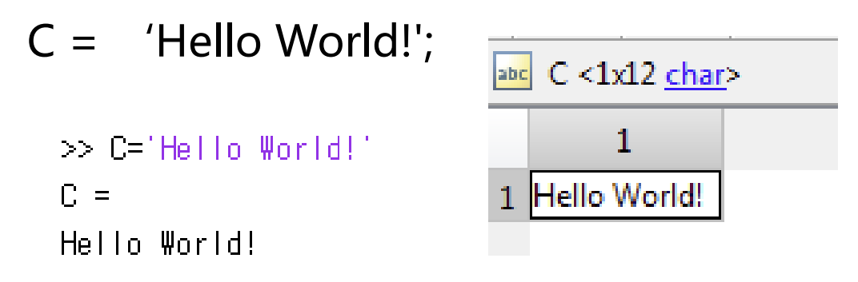
Variables

Slide 11
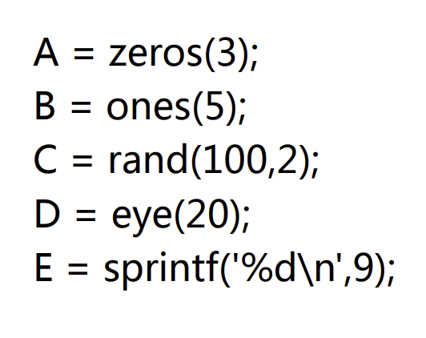
Variables

Slide 12
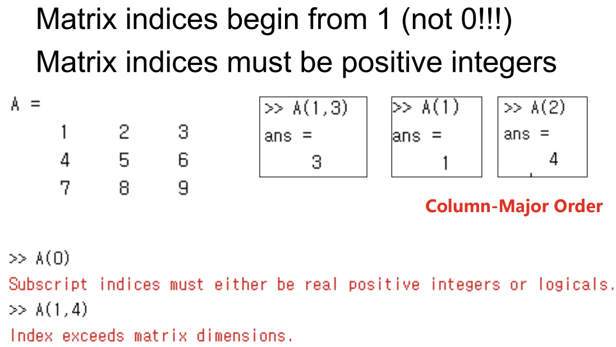
Matrix Index

Slide 13
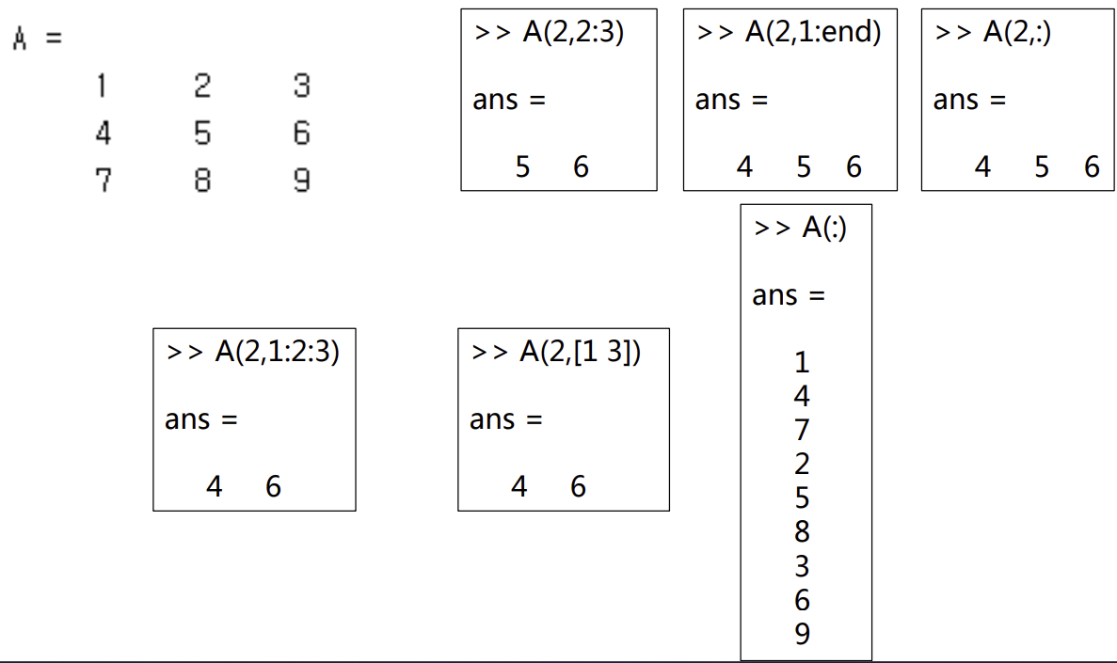
Matrix Index

Slide 14
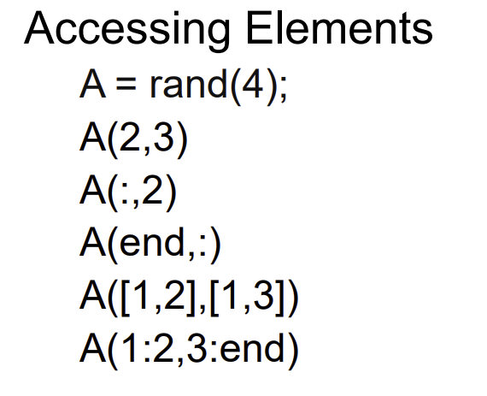
Matrix Index

Slide 15
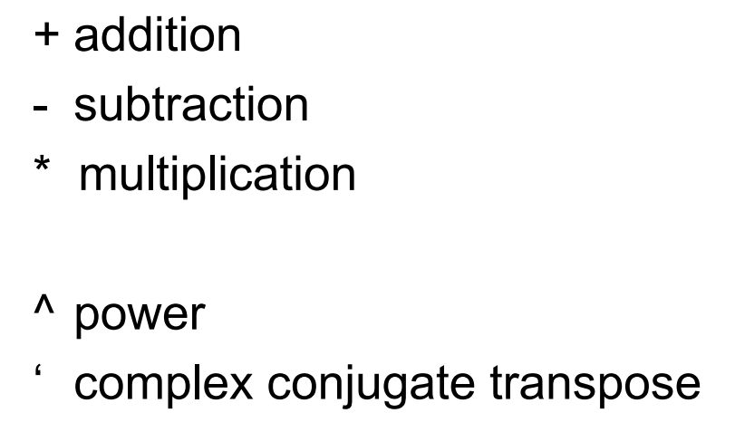
Matrix Operations

Slide 16
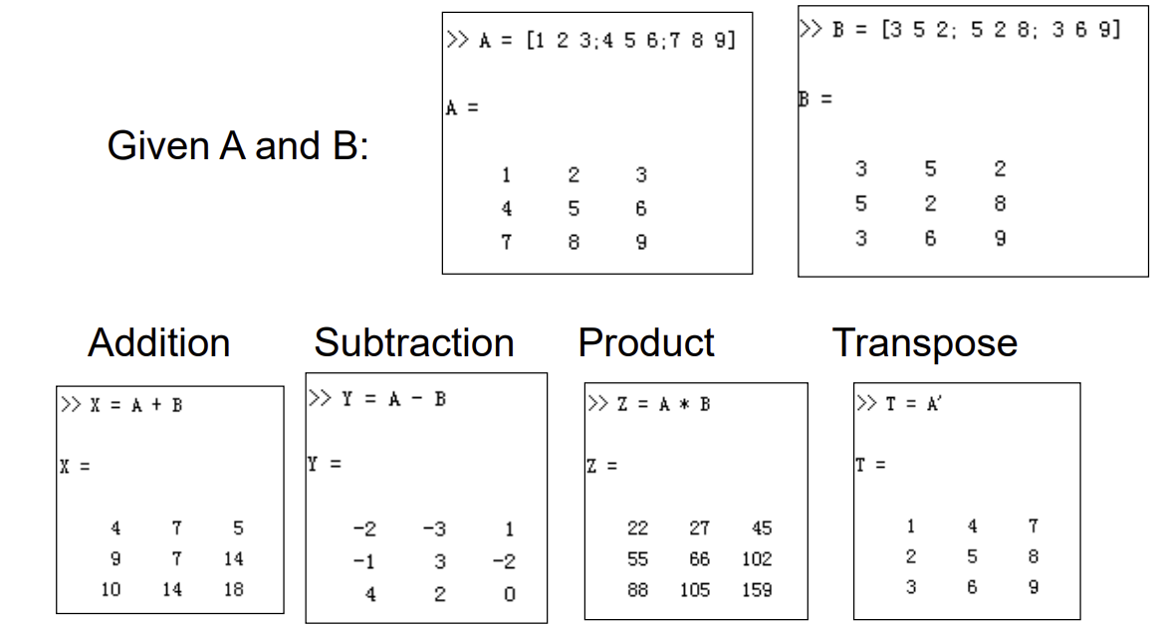
Matrix Operations

Slide 17
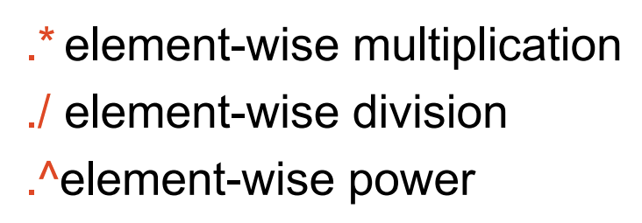
Matrix Operations

Slide 18
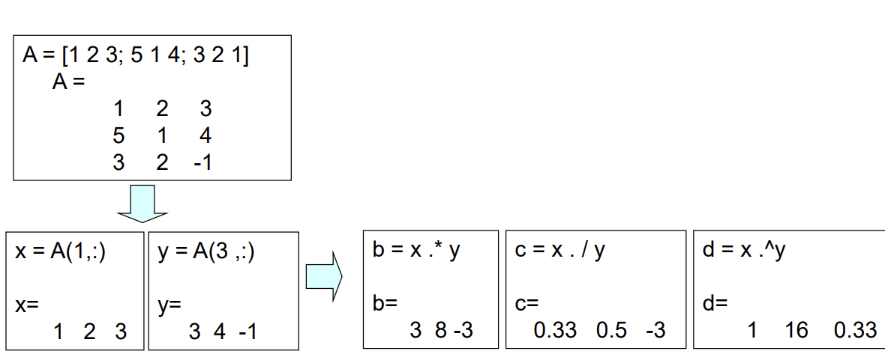
Matrix Operations

Slide 19
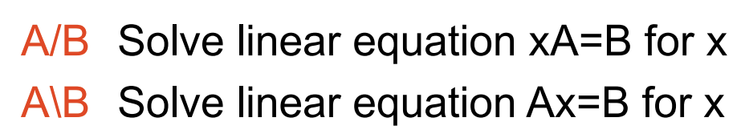
Matrix Operations

Slide 20
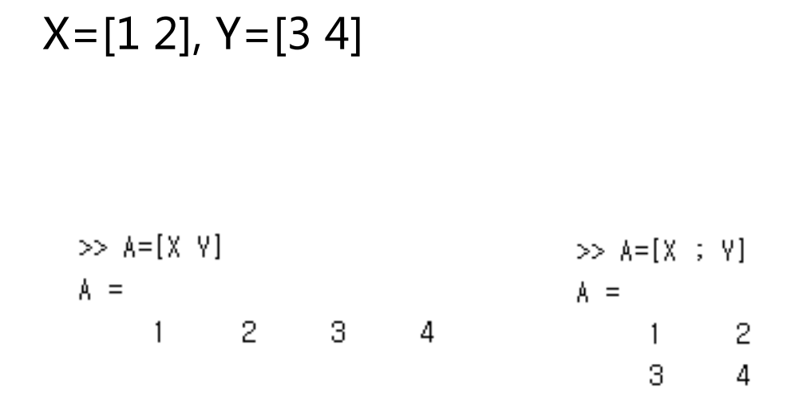
Matrix Concatenation

Slide 21
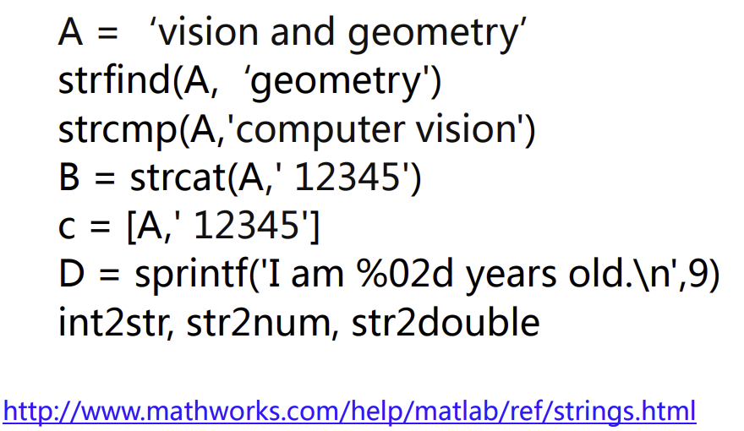
Strings

Slide 22
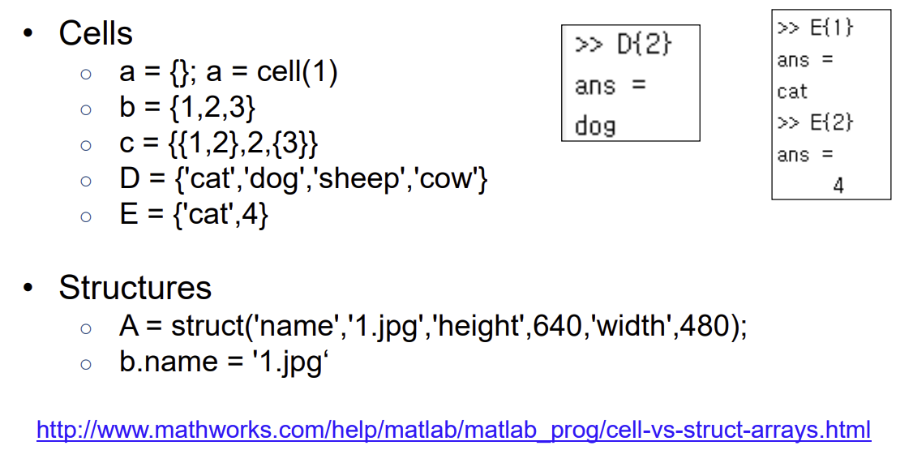
Cells and structure

Slide 23
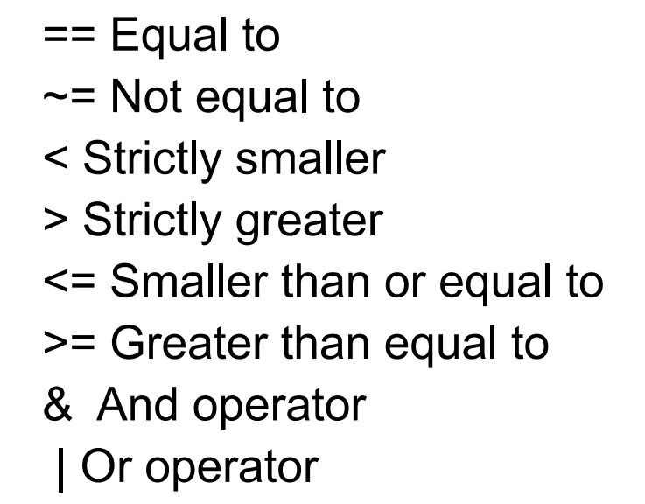
Operators

Slide 24
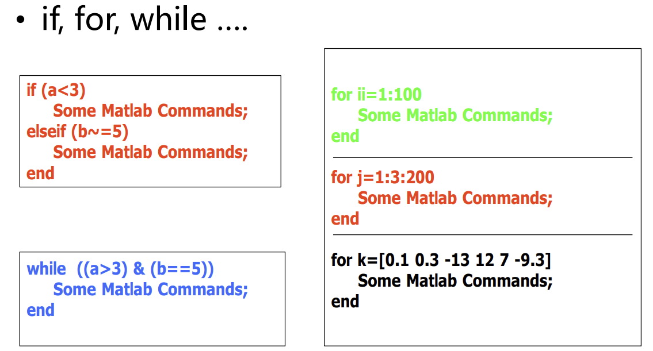
Flow control

Slide 25
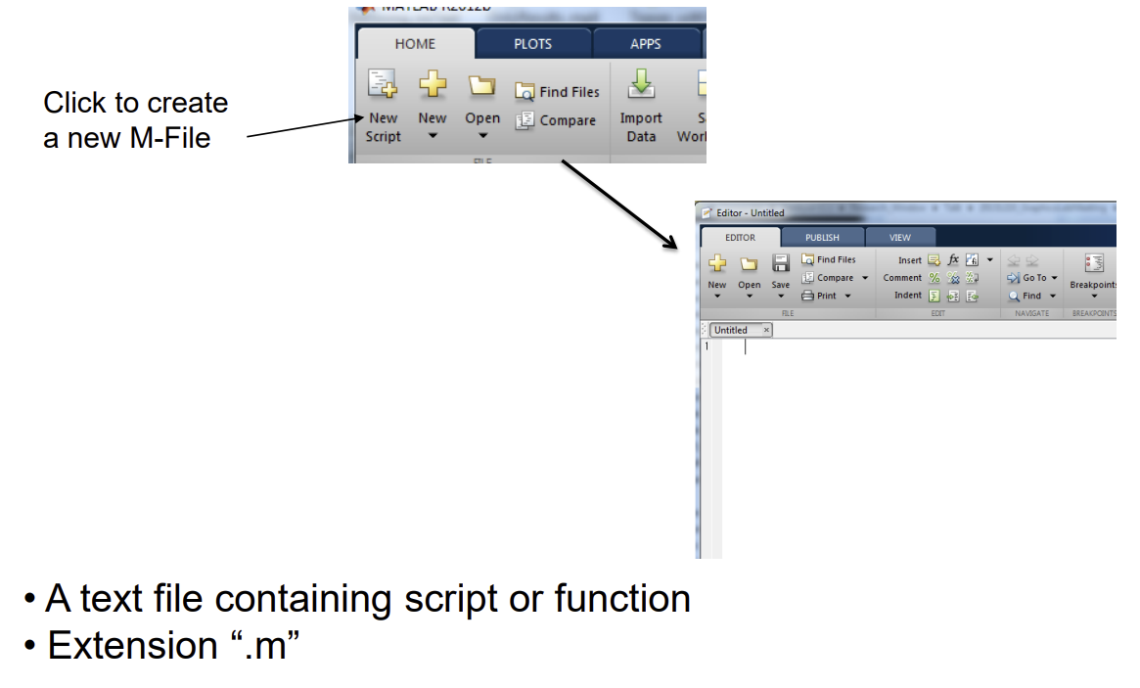
M file

Slide 26
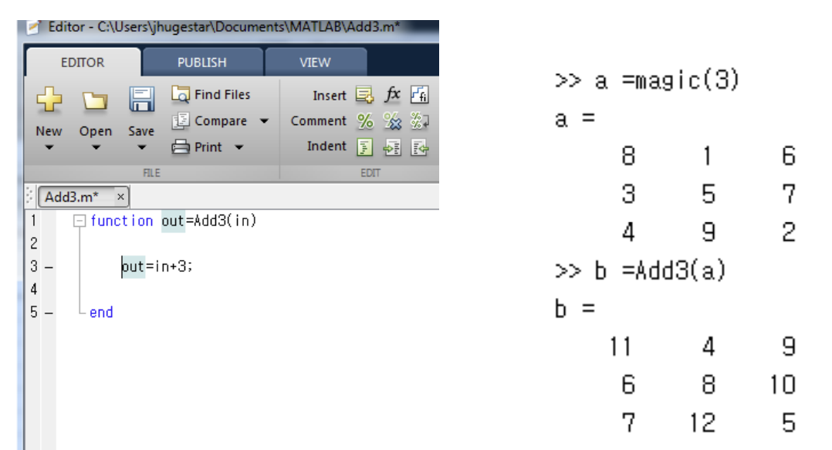
Functions

Slide 27
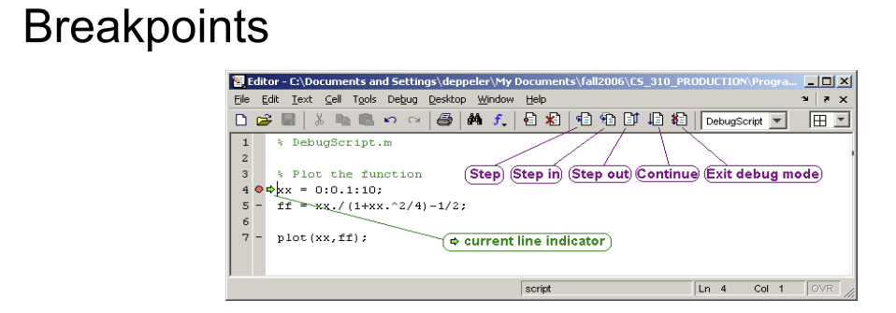
Debugging

Slide 28
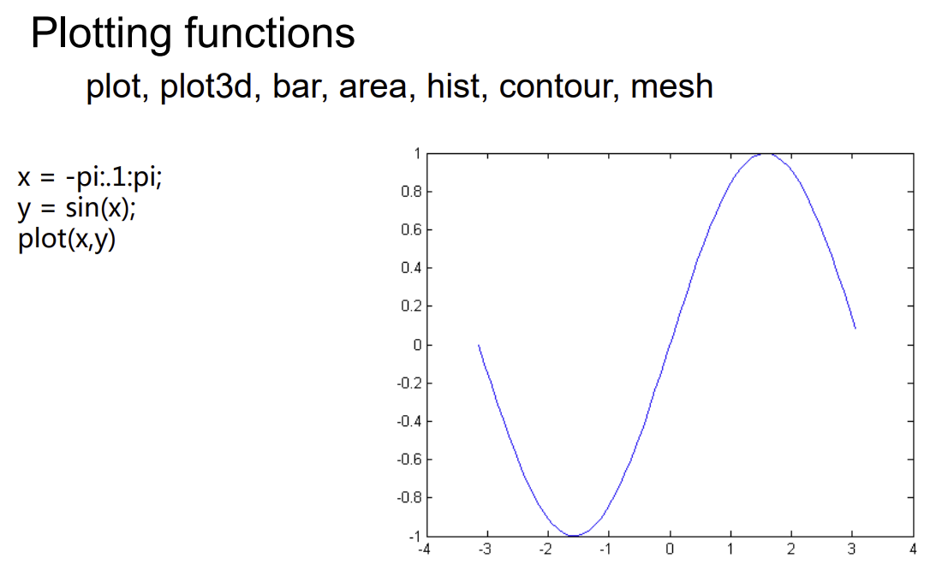
Plotting

Slide 29
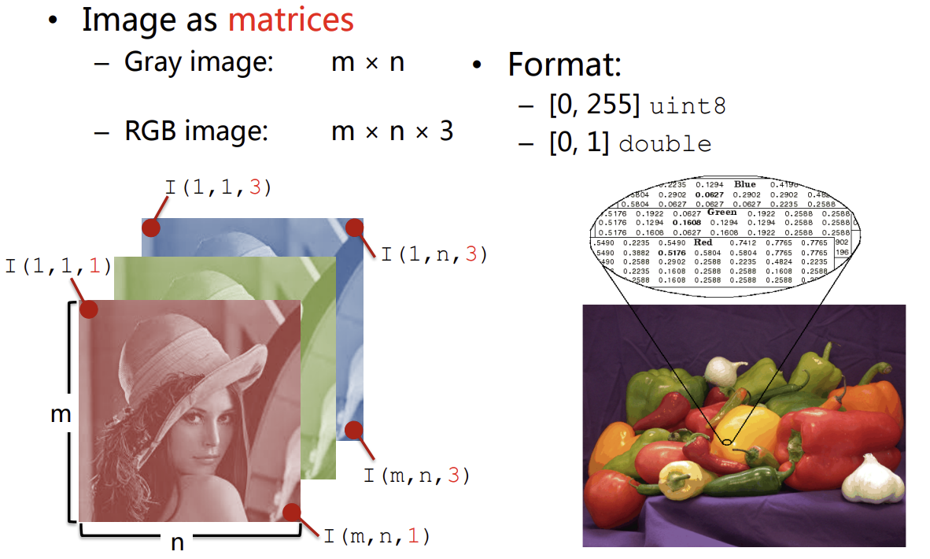
Image Data Structure

Slide 30
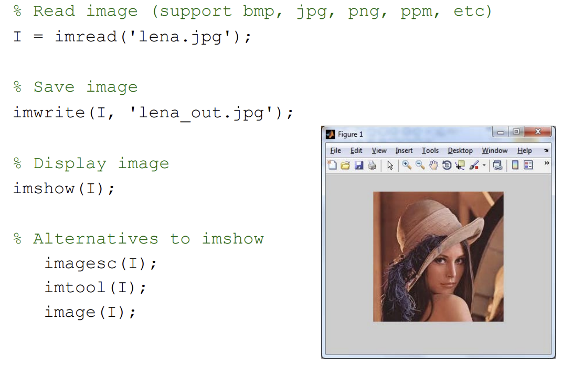
Image I/O/Display

Slide 31
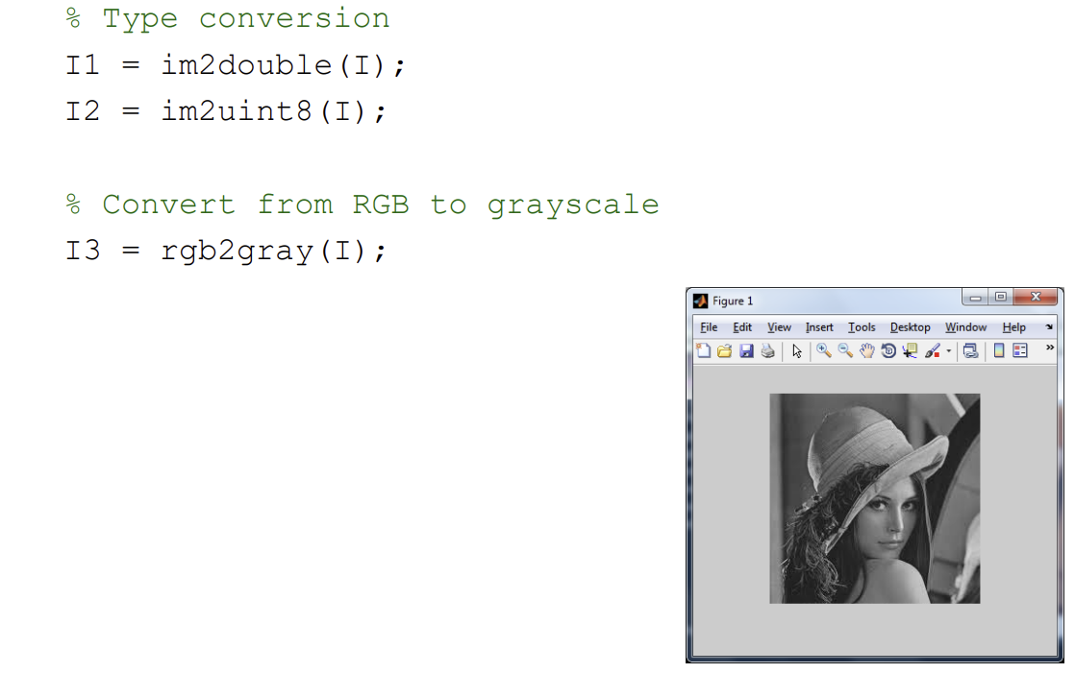
Image Conversions

Slide 32
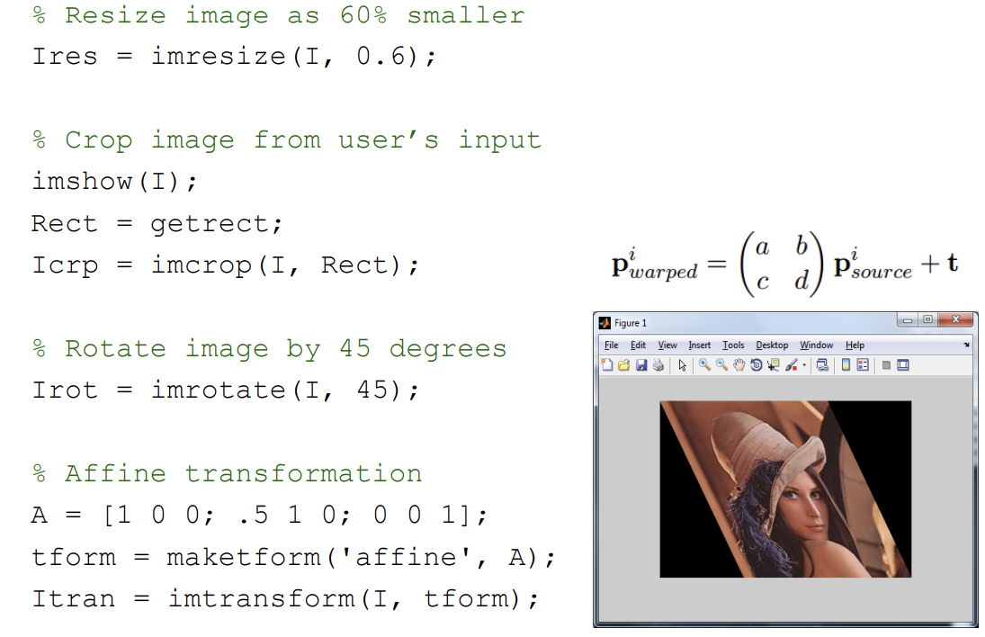
Image Operations

Slide 33
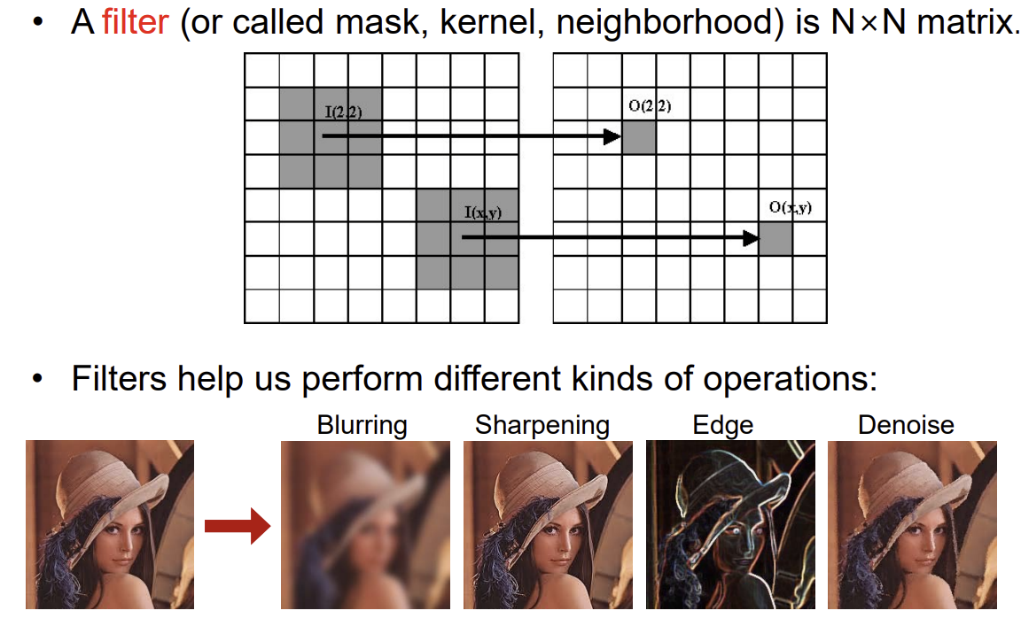
Image Filtering / Convolution

Slide 34
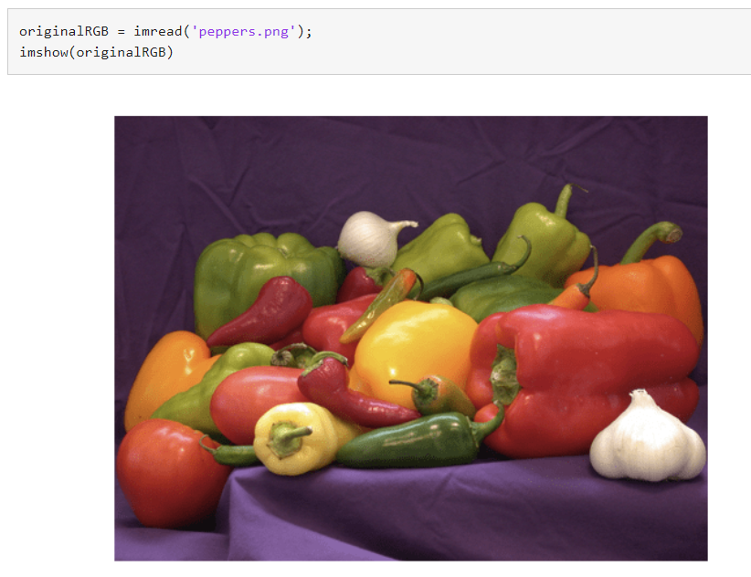
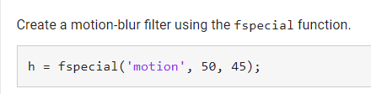
Image Filtering

Slide 35
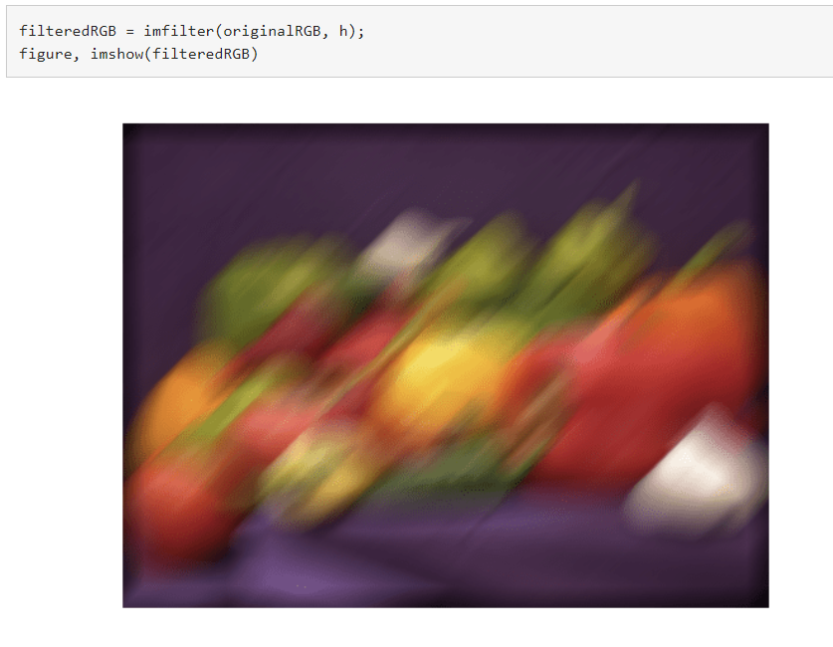
Image Filtering

Slide 36
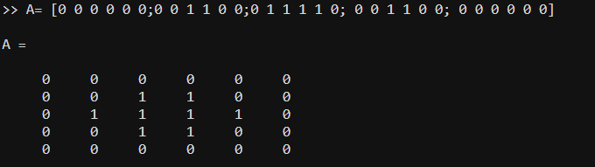
Morphological operation
A = [000000 ; 001100; 011110; 001100; 000000]
B= strel([1;1;1])
A_eroded_By_B= imerode(A,B)

Slide 37
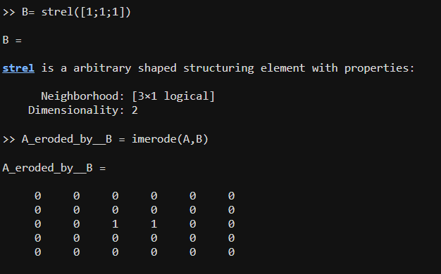
Morphological operation

Slide 38
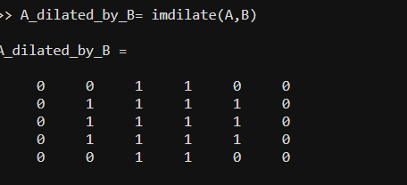
Morphological operation

Slide 39
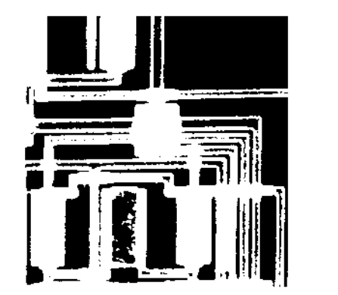




Morphological operation

Slide 40
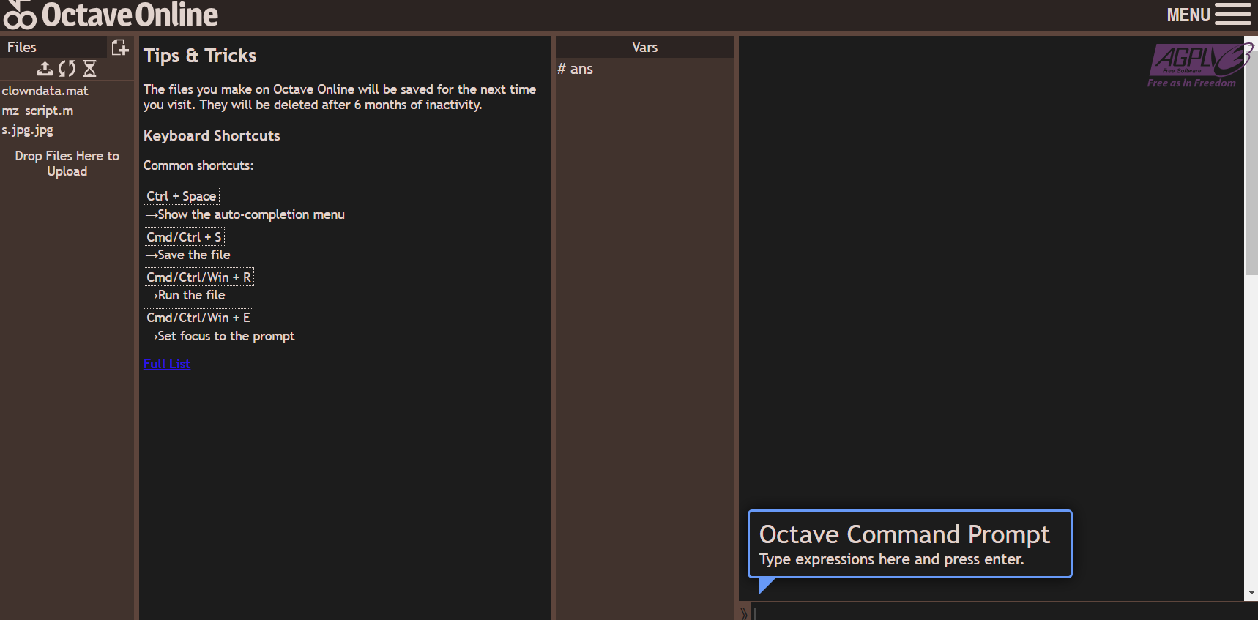
Octave
File or data
Write command

Slide 41
Octave
Load data
Image(X)
Colormap(map)
B=X(1:2:200,:);
Image(B)

Slide 42
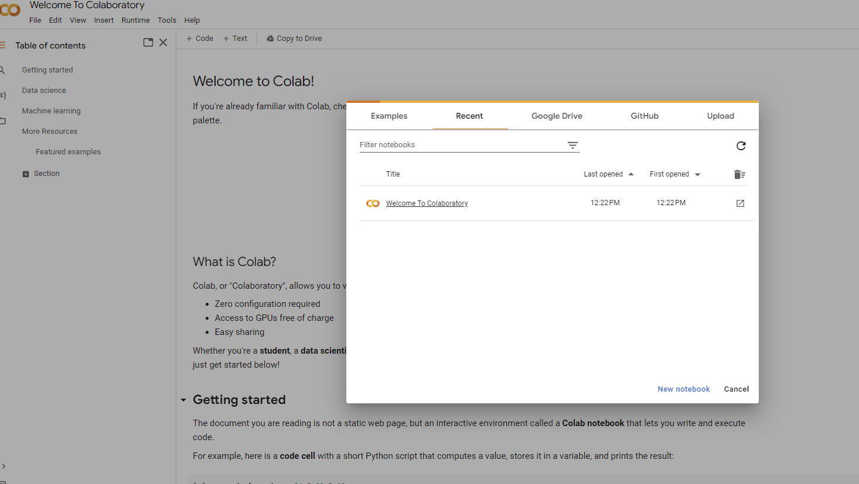

Google Colab

Slide 43
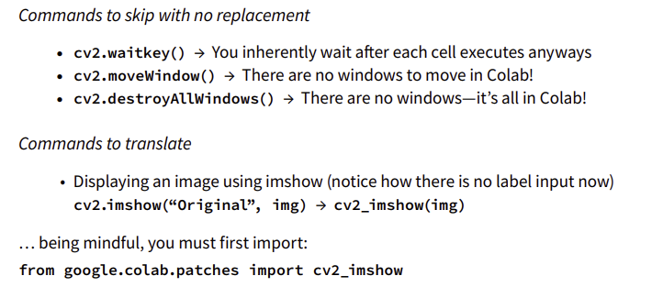
Google Colab

Slide 44
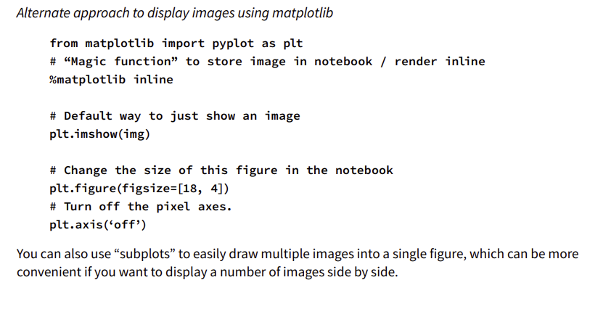
Google Colab

Slide 45
Reference
http://www-mdp.eng.cam.ac.uk/web/CD/engapps/octave/octavetut.pdf

Slide 46

Question

Slide 47

Thank you

